Slide 1



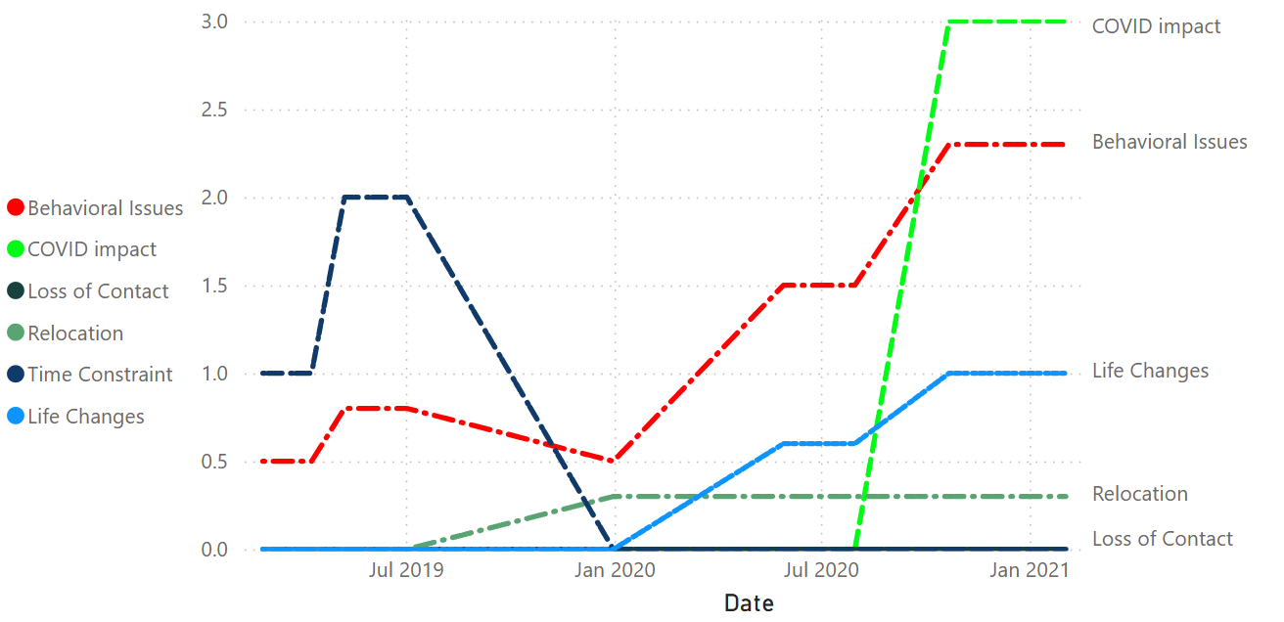









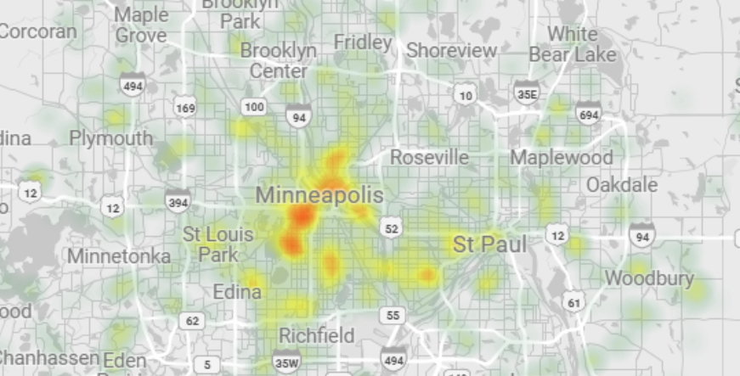



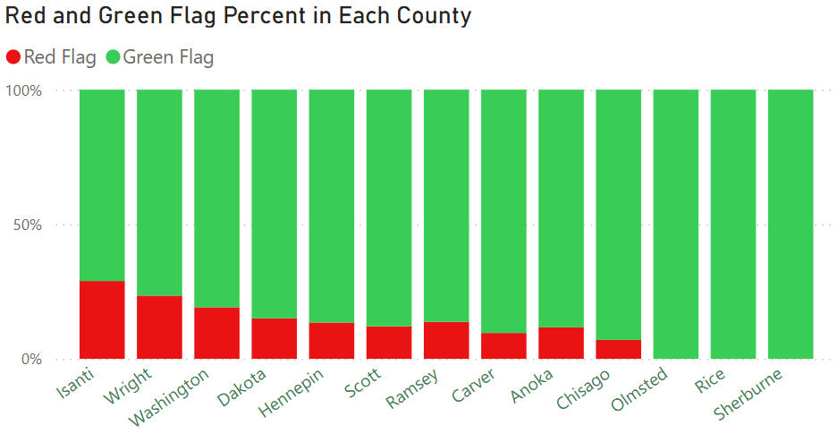
As-Is Situation (Manual Effort | Lack Of Visibility)
Our Solution (Automation | Visibility | Alerts)
Match Event View
Spreadsheet Update
Match Coordinator
Match Coordinator
LLM Call Bot
Speech Recognition
Match Event View
Time Consuming
LLM
(Event Detection)
Each MEC may coordinate up to 60 Volunteers / Matches
60 Volunteers / Matches

Slide 3

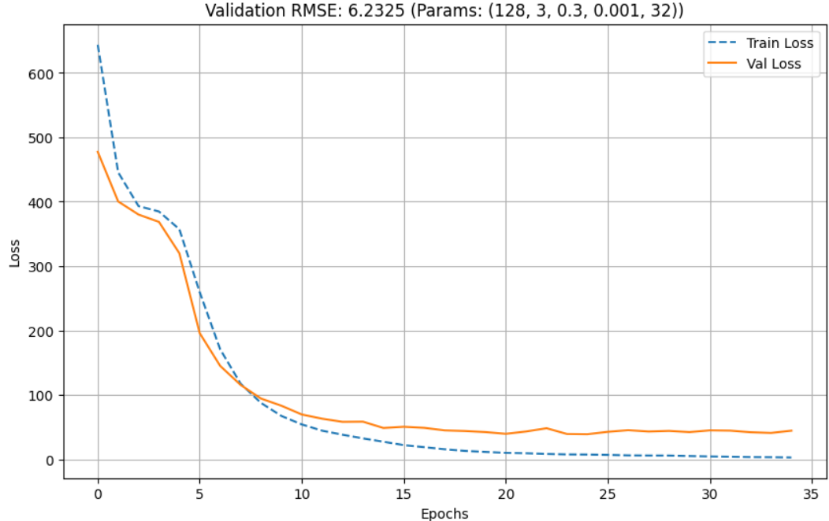
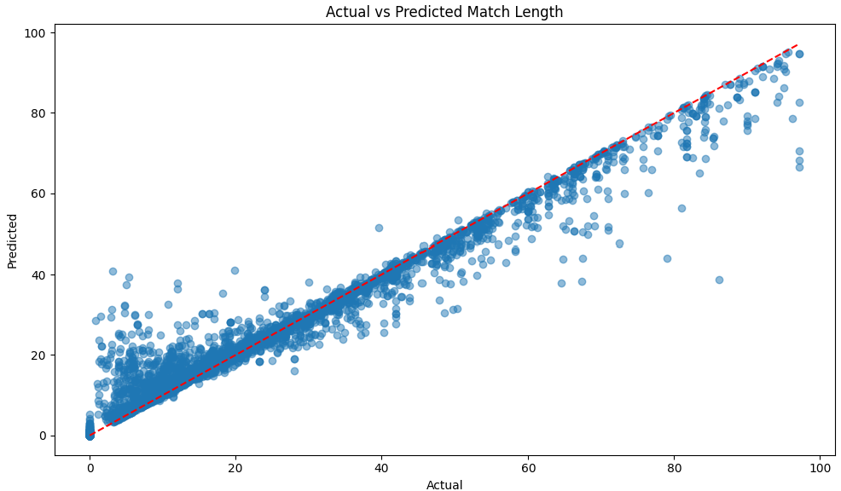



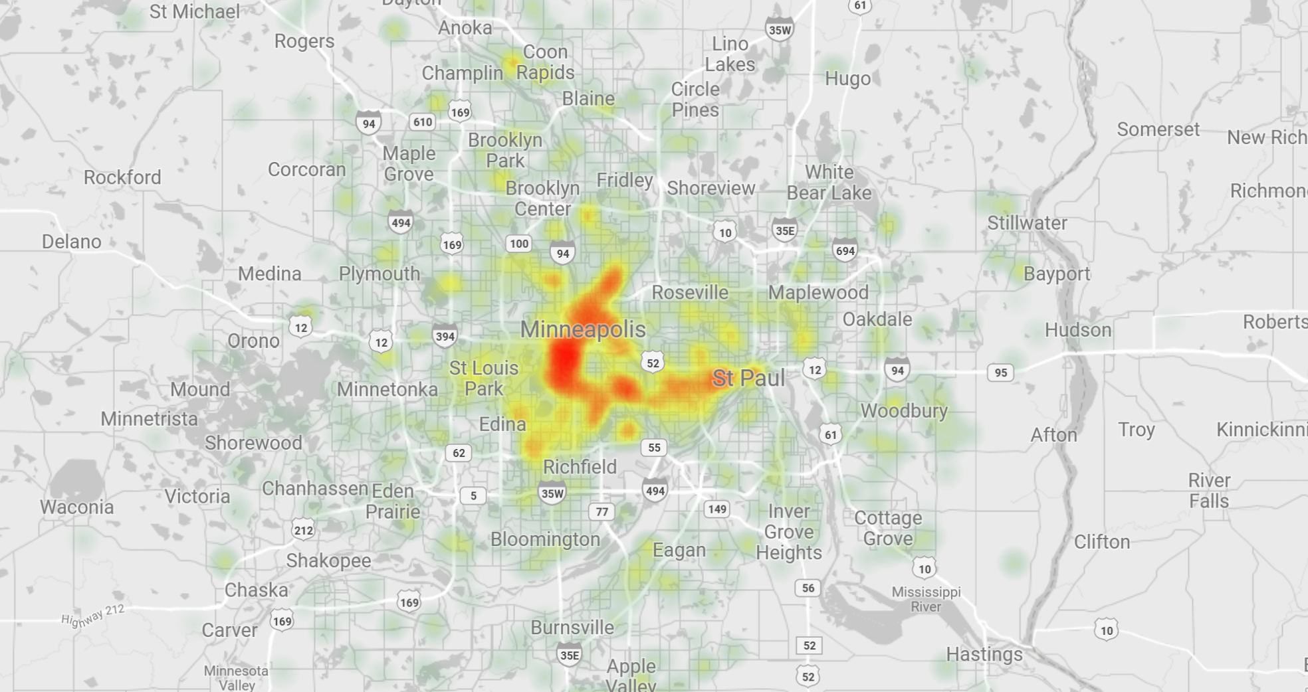




Pipeline Overview
Model Prediction
LSTM (Deep Learning)
Train Dataset
Data & Alert Driven Decision
Test Dataset
Manual Data Cleaning
Power Bi
XAI GROK
(Event Detection)
External Data
Research Papers
GeoPandas
USA Census
BBB
Google Scholar
Data Producers
Data Processing Pipeline
Data Consumers

Slide 4



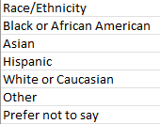
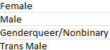
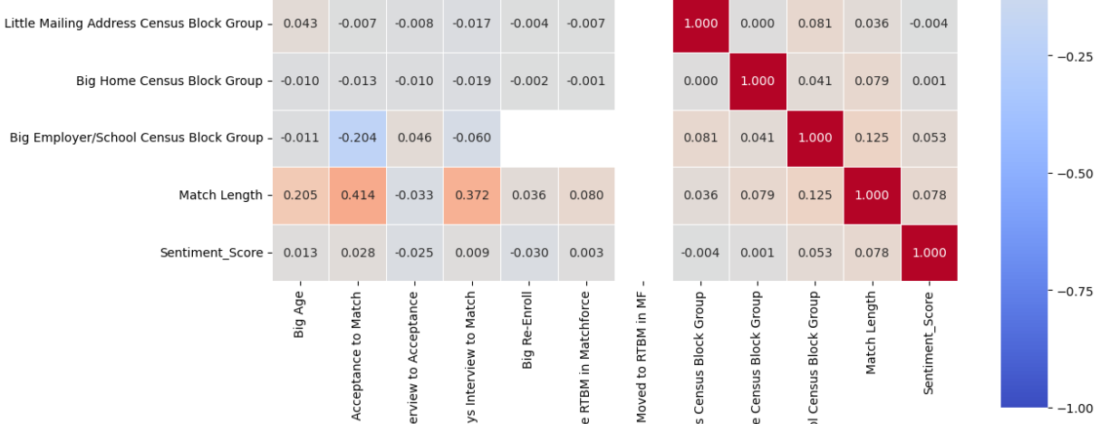
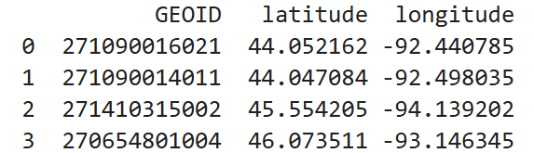
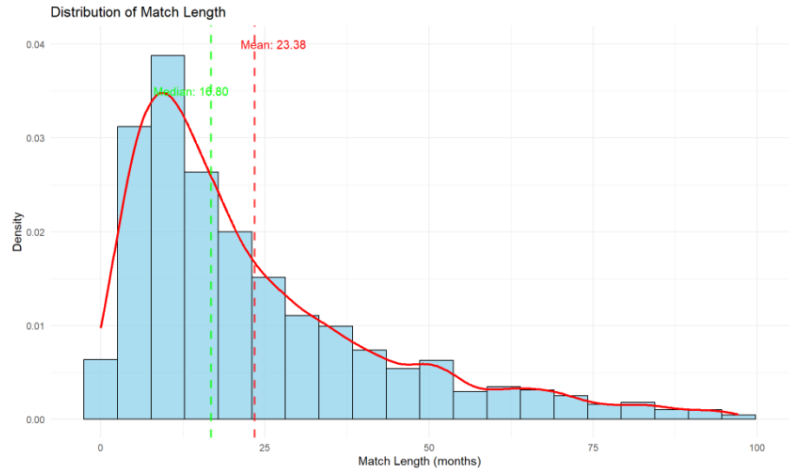
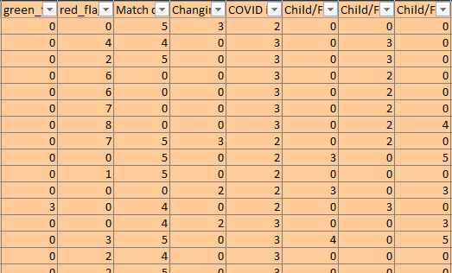
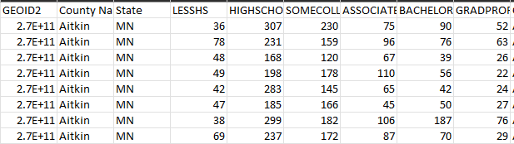
Manual Processing
Match Length Stats Analysis with Pandas:
Correlation
Standard Deviation
Outliers
Closure Seasons
Recategorization of categories to reduce category Count:
Gender
Race
Education Level
Occupation
Extract centroid (Latitude, Longitude) From .shp files for each census block.
- Adds Distance Value between Big and Small
GeoPandas
GeoPandas
Transformation of nested Temporal Features into column Features for LSTM Training.
Impute/Add missing Columns:
Education
Mean / Median Income
Race
USA Census

Slide 5


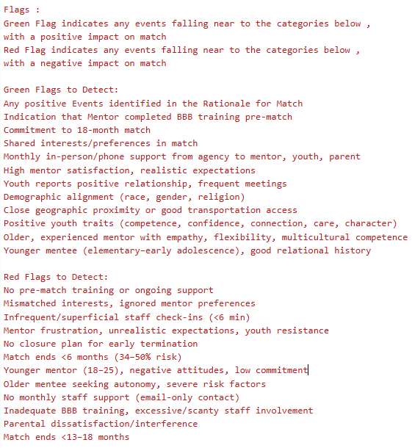
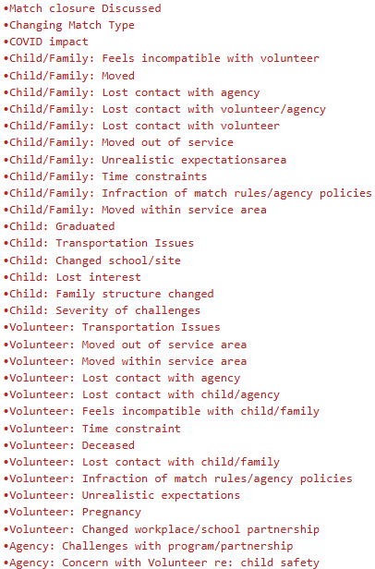


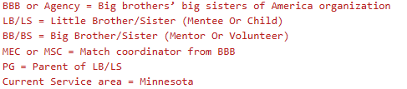
Prompt Context
Research Papers
Context Prompt Green / Red Flags (Cached Context)
Context Prompt Negative Events
(Cached Context)
BBB
Google Scholar

Slide 6

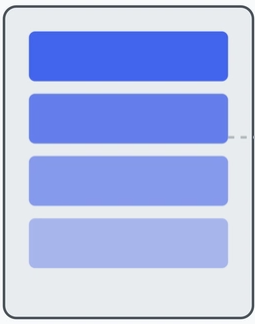
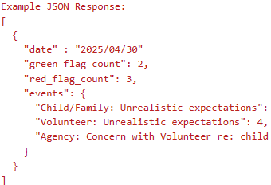

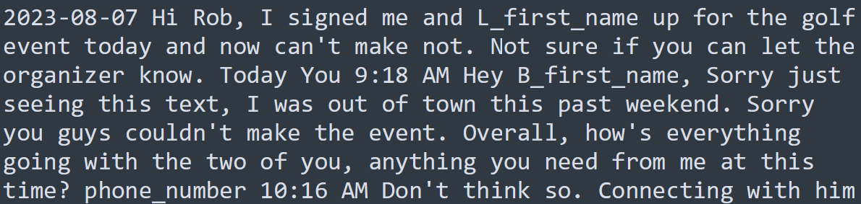
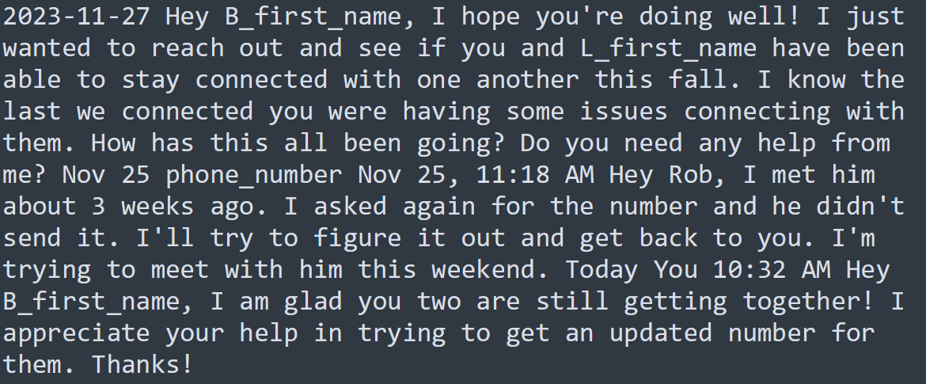
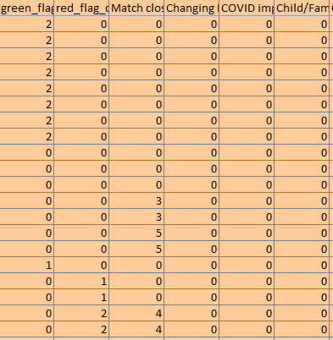
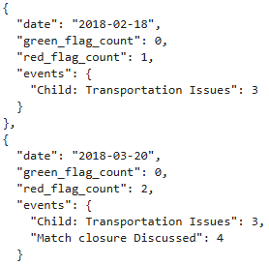
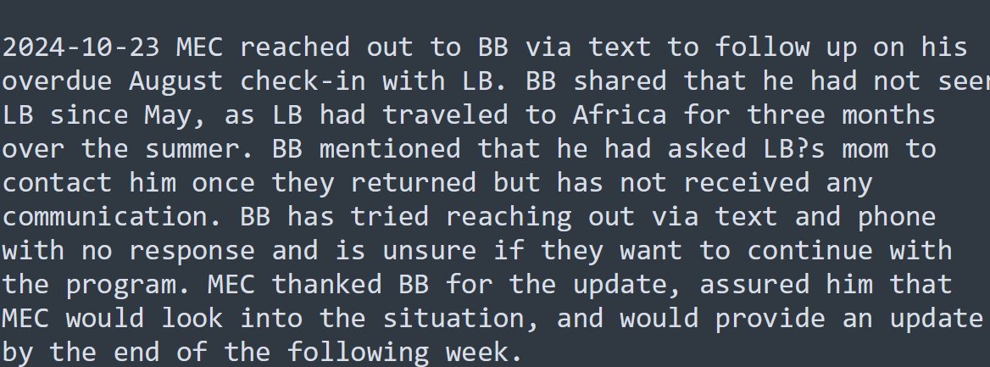

Grok Query Structure
Monthly Volunteer Mentor Catchup Notes
Output Format Prompt
Output Validation
Context Cache
Optimization to reduce input token count
Serialize Into JSON
Context Information (Flags & Events)
Transpose Feature To Columns
Match Rational Notes, events mentioned here doubles the green flag count

Slide 7
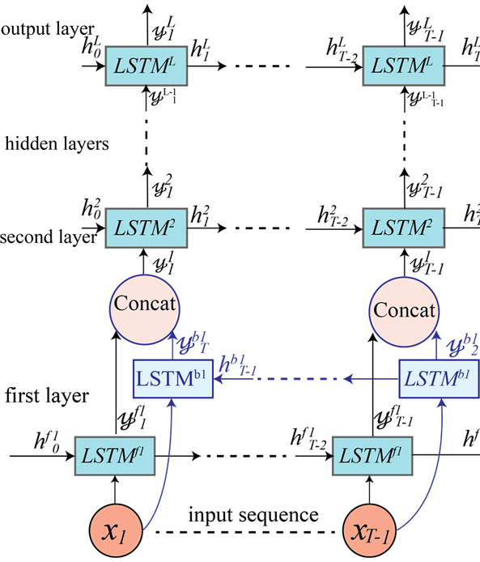
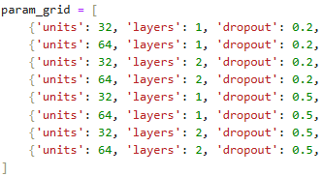
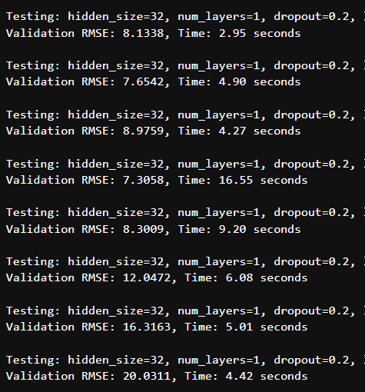

LSTM Pipeline
Feature Engineering
NParray Sequence
LSTM Model Parameters
Hyperparameter Tuning
0
1
n
Numerical Columns
Categorical Columns
Hidden Size:
256
Layers:
2
Learning Rate: 0.0005
Batch Size:
32
Regularization:
0.3
X = [R3 , R4 , R5, R6] | Y =R7[Match Len]
X = [R1 , R2 , R3, R4] | Y =R5[Match Len]
X = [R2 , R3 , R4, R5] | Y =R6[Match Len]
Normalization
One Hot Encoder
KNN Imputer (K=5)
Predictions

Slide 8
Train & Test Dataset
JSON Serialize
GeoPandas
Manual Data Cleaning
LSTM
USA Census
XAI GROK
Power Bi

Slide 9
